Slide 1

National University of Computer and Emerging Sciences
Convolutional Neural Networks
AI-5004 Adv. Topics in Generative AI
Dr. Muhammad Nouman Noor
Department of AI & DS

Slide 2
Goals
Today’s Lecture
Matrix Operations
Convolution Operations
Convolutional Neural Networks

Slide 3
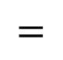
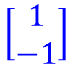
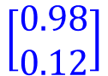

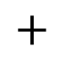
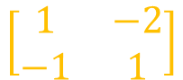
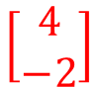
Matrix Operation
Introduction to Neural Networks
Matrix operations are helpful when working with multidimensional inputs and outputs
1
4
0.98
1
W
x
b
a
+
-2
$σ\left( \right) =$
-1
-2
0.12
$$\left[\begin{matrix}1 & −2 \\ −1 & 1\end{matrix}\right]$$
$$\left[\begin{matrix}1 \\ −1\end{matrix}\right]$$
$$=$$
$$\left[\begin{matrix}0.98 \\ 0.12\end{matrix}\right]$$
$$σ\left( × \right)$$
$$+$$
$$1$$
-1
1
$$\left[\begin{matrix}4 \\ −2\end{matrix}\right]$$
1
Slide credit: Hung-yi Lee – Deep Learning Tutorial

Slide 4
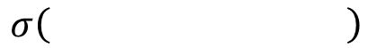
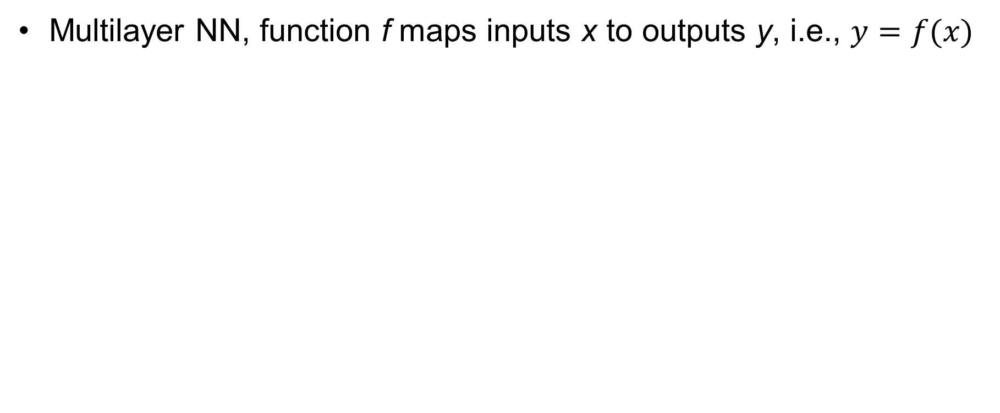
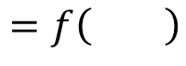
Matrix Operation
Introduction to Neural Networks
Multilayer NN, function f maps inputs x to outputs y, i.e., $y=f(x)$
……
y₁
W¹
W²
W^{L}
y₂
……
b¹
b²
b^{L}
……
……
……
……
……
x
a¹
a²
y
……
y_{M}
y
x
W^{L}
…
W²
W¹
x
b¹
b²
…
b^{L}
$$=f\left( \right)$$
+
+
$$=σ\left( \right)$$
$$σ\left( \right)$$
+
$$σ\left( \right)$$
Slide credit: Hung-yi Lee – Deep Learning Tutorial

Slide 5
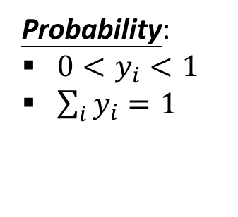
Softmax Layer
Introduction to Neural Networks
The softmax layer applies softmax activations to output a probability value in the range [0, 1]
The values z inputted to the softmax layer are referred to as logits
A Softmax Layer
Probability:
$0<y_{i}<1$
$\sum_{i}{y_{i}=1}$
3
20
0.88
1
2.7
0.12
-3
0.05
≈0
Slide credit: Hung-yi Lee – Deep Learning Tutorial

Slide 6
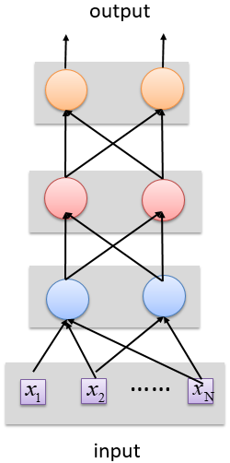
Deep vs Shallow Networks
Deep vs Shallow Networks
Deeper networks perform better than shallow networks
But only up to some limit: after a certain number of layers, the performance of deeper networks plateaus
output
Shallow NN
Deep NN
#Layer
Representation
……
……
input
Slide credit: Hung-yi Lee – Deep Learning Tutorial

Slide 7
Introduction to Convolutional Neural Networks

Slide 8
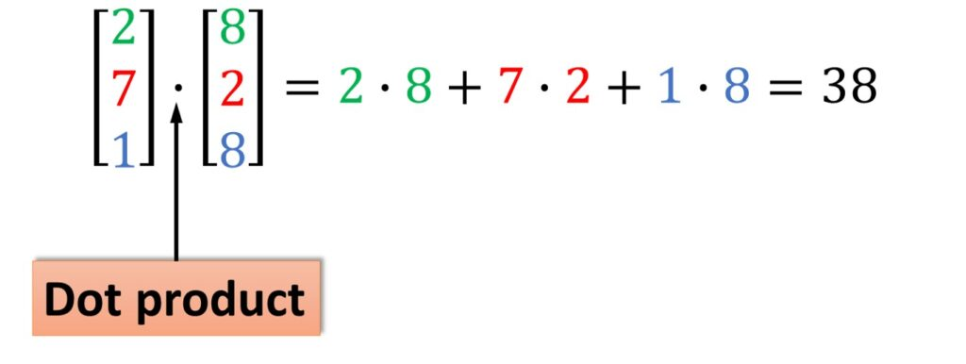
Multiplication and Dot Product

Slide 9
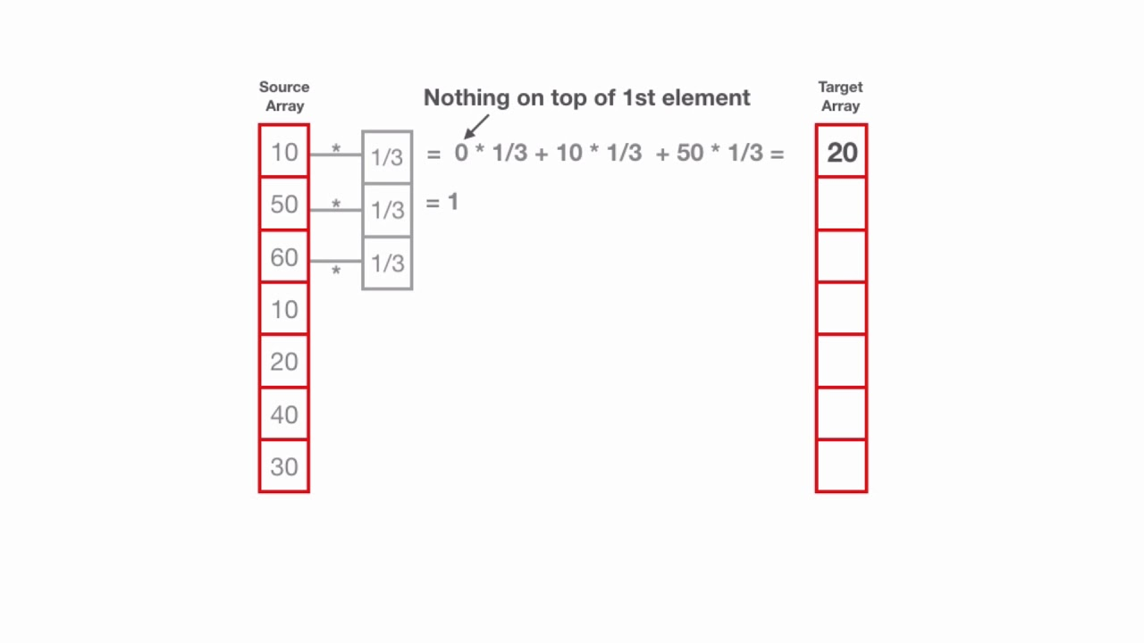
Convolution Operation

Slide 10
Convolution Operation in 1D

Slide 11
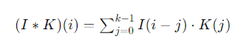
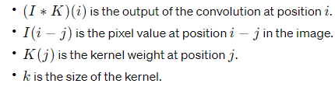
Convolution in 1D

Slide 12
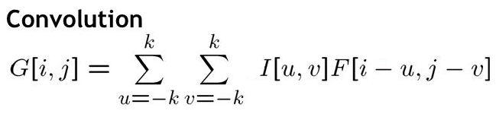
Convolution Operation
Convolution

Slide 13
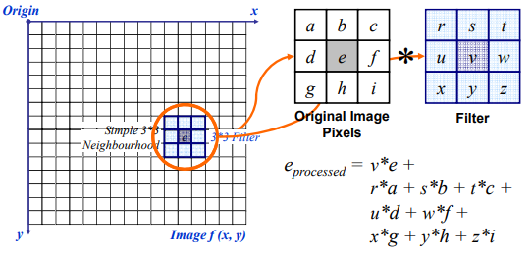
Convolution Operation

Slide 14

Convolution

Slide 15
What are CNNs ?
CNN = Neural Network with a convolution operation
Convolutional neural networks (CNN, ConvNet) is a class of deep, feed-forward artificial neural networks that are applied to analyzing visual imagery.
Consists of Matrix Multiplication in at least one of the layers

Slide 16
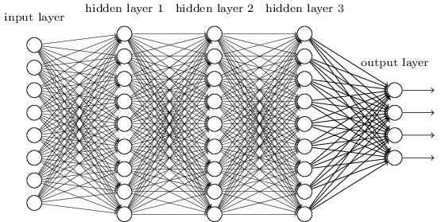
Smaller Network: CNN
We know it is good to learn a small model.
From this fully connected model, do we really need all the edges?
Can some of these be shared?

Slide 17

Convolutional Neural Networks (CNNs)
Convolutional Neural Networks
Feature extraction architecture
After 2 convolutional layers, a max-pooling layer reduces the size of the feature maps (typically by 2)
A fully convolutional and a softmax layers are added last to perform classification
Living Room
Bedroom
64
64
128
128
256
256
256
512
512
512
512
512
512
Kitchen
Bathroom
Conv layer
Max Pool
Outdoor
Fully Connected Layer
Slide credit: Param Vir Singh – Deep Learning

Slide 18
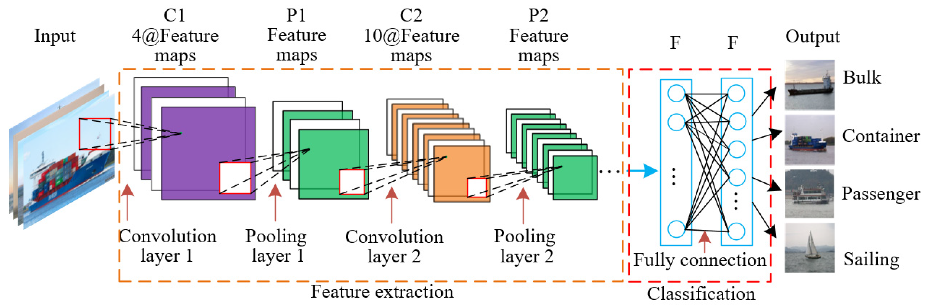
CNN architecture

Slide 19
Convolutional Neural Networks (CovNet)
In a nutshell, A ConvNet usually has 3 types of layers: 1) Convolutional Layer (CONV) 2) Pooling Layer (POOL) 3) Fully Connected Layer (FC)

Slide 20
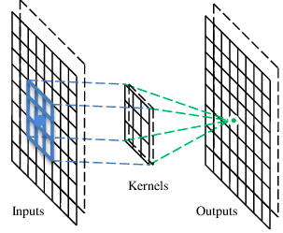
A convolutional layer
A CNN is a neural network with some convolutional layers
(and some other layers). A convolutional layer has a number
of filters that does convolutional operation.
Beak detector
A filter

Slide 21
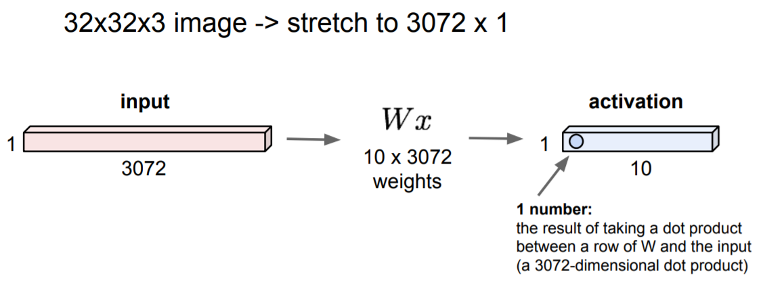
Fully Connected Layer

Slide 22
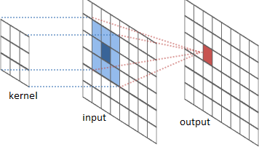
The convolution operation

Slide 23
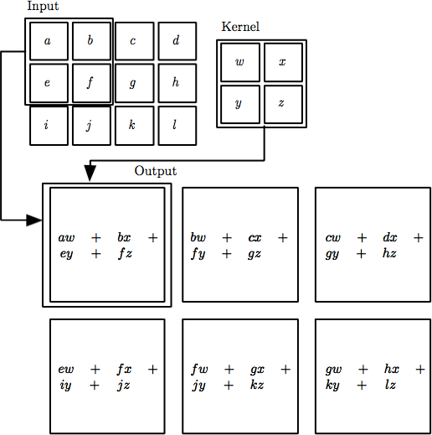

The convolution operation
Local Connectivity. Neurons will connect to only a local region of the input volume.
The spatial extent of this connectivity is a hyperparameter called the receptive field of the neuron (equivalently this is the filter size).

Slide 24
Convolution
These are the network parameters to be learned.
1 | -1 | -1
-1 | 1 | -1
-1 | -1 | 1
1 | 0 | 0 | 0 | 0 | 1
0 | 1 | 0 | 0 | 1 | 0
0 | 0 | 1 | 1 | 0 | 0
1 | 0 | 0 | 0 | 1 | 0
0 | 1 | 0 | 0 | 1 | 0
0 | 0 | 1 | 0 | 1 | 0
Filter 1
-1 | 1 | -1
-1 | 1 | -1
-1 | 1 | -1
Filter 2
……
6 x 6 image
Each filter detects a small pattern (3 x 3).

Slide 25
Convolution
stride=1
1 | -1 | -1
-1 | 1 | -1
-1 | -1 | 1
1 | 0 | 0 | 0 | 0 | 1
0 | 1 | 0 | 0 | 1 | 0
0 | 0 | 1 | 1 | 0 | 0
1 | 0 | 0 | 0 | 1 | 0
0 | 1 | 0 | 0 | 1 | 0
0 | 0 | 1 | 0 | 1 | 0
Dot
product
3
-1
Filter 1
6 x 6 image

Slide 26
Convolution
1 | -1 | -1
-1 | 1 | -1
-1 | -1 | 1
Filter 1
If stride=2
1 | 0 | 0 | 0 | 0 | 1
0 | 1 | 0 | 0 | 1 | 0
0 | 0 | 1 | 1 | 0 | 0
1 | 0 | 0 | 0 | 1 | 0
0 | 1 | 0 | 0 | 1 | 0
0 | 0 | 1 | 0 | 1 | 0
3
-3
6 x 6 image

Slide 27
Convolution
Filter 1
stride=1
1 | -1 | -1
-1 | 1 | -1
-1 | -1 | 1
1 | 0 | 0 | 0 | 0 | 1
0 | 1 | 0 | 0 | 1 | 0
0 | 0 | 1 | 1 | 0 | 0
1 | 0 | 0 | 0 | 1 | 0
0 | 1 | 0 | 0 | 1 | 0
0 | 0 | 1 | 0 | 1 | 0
3
-1
-3
-1
-3
1
0
-3
-3
-3
0
1
3
-2
-2
-1
6 x 6 image

Slide 28
Convolution
-1 | 1 | -1
-1 | 1 | -1
-1 | 1 | -1
Filter 2
stride=1
Repeat this for each filter
1 | 0 | 0 | 0 | 0 | 1
0 | 1 | 0 | 0 | 1 | 0
0 | 0 | 1 | 1 | 0 | 0
1 | 0 | 0 | 0 | 1 | 0
0 | 1 | 0 | 0 | 1 | 0
0 | 0 | 1 | 0 | 1 | 0
3
-1
-3
-1
-1
-1
-1
-1
-3
1
0
-3
-1
-1
-2
1
Feature
Map
-3
-3
0
1
-1
-1
-2
1
3
-2
-2
-1
6 x 6 image
-1
0
-4
3
Two 4 x 4 images
Forming 2 x 4 x 4 matrix

Slide 29
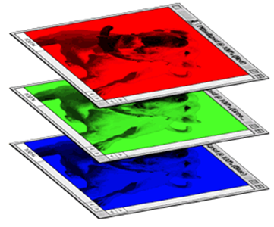
Color image: RGB 3 channels
1 | -1 | -1
-1 | 1 | -1
-1 | -1 | 1
-1 | 1 | -1
-1 | 1 | -1
-1 | 1 | -1
1 | -1 | -1
-1 | 1 | -1
-1 | -1 | 1
-1 | 1 | -1
-1 | 1 | -1
-1 | 1 | -1
1 | -1 | -1
-1 | 1 | -1
-1 | -1 | 1
-1 | 1 | -1
-1 | 1 | -1
-1 | 1 | -1
Filter 1
Filter 2
Color image
1 | 0 | 0 | 0 | 0 | 1
0 | 1 | 0 | 0 | 1 | 0
0 | 0 | 1 | 1 | 0 | 0
1 | 0 | 0 | 0 | 1 | 0
0 | 1 | 0 | 0 | 1 | 0
0 | 0 | 1 | 0 | 1 | 0
1 | 0 | 0 | 0 | 0 | 1
0 | 1 | 0 | 0 | 1 | 0
0 | 0 | 1 | 1 | 0 | 0
1 | 0 | 0 | 0 | 1 | 0
0 | 1 | 0 | 0 | 1 | 0
0 | 0 | 1 | 0 | 1 | 0
1 | 0 | 0 | 0 | 0 | 1
0 | 1 | 0 | 0 | 1 | 0
0 | 0 | 1 | 1 | 0 | 0
1 | 0 | 0 | 0 | 1 | 0
0 | 1 | 0 | 0 | 1 | 0
0 | 0 | 1 | 0 | 1 | 0

Slide 30
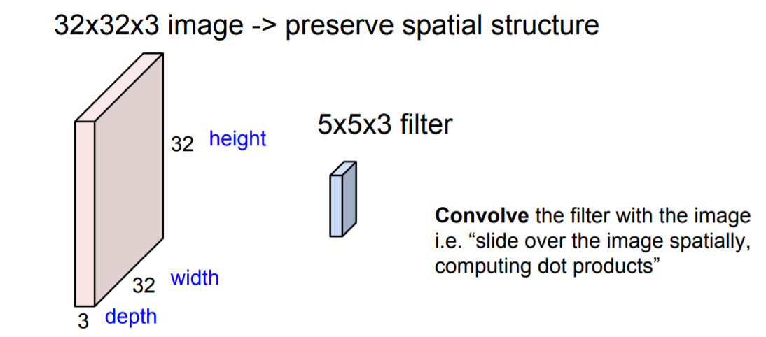
Convolution Layer

Slide 31
Convolution Layer
32x32x3 image
32
height
32
depth
width
3

Slide 32
Convolution Layer
32x32x3 image
5x5x3 filter
32
Convolve the filter with the image
i.e. “slide over the image spatially, computing dot products”
32
3

Slide 33
Convolution Layer
Filters always extend the full
32x32x3 image
depth of the input volume
5x5x3 filter
32
Convolve the filter with the image
i.e. “slide over the image spatially, computing dot products”
32
3

Slide 34
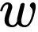
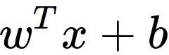
Convolution Layer
32x32x3 image 5x5x3 filter
32
1 number:
the result of taking a dot product between the filter and a small 5x5x3 chunk of the image
(i.e. 5*5*3 = 75-dimensional dot product + bias)
32
3

Slide 35
Convolution Layer
activation map
32x32x3 image 5x5x3 filter
32
28
convolve (slide) over all spatial locations
32
28
3
1

Slide 36
Convolution Layer
32x32x3 image 5x5x3 filter
activation maps
32
28
convolve (slide) over all spatial locations
32
28
consider a second, green filter
3
1

Slide 37
For example, if we had 6 5x5 filters, we’ll get 6 separate activation maps:
activation maps
32
28
Convolution Layer
32
28
3
6
We stack these up to get a “new image” of size 28x28x6!

Slide 38
Preview: ConvNet is a sequence of Convolutional Layers, interspersed with activation functions
32
28
24
….
CONV, ReLU
e.g. 6 5x5x3 filters
CONV, ReLU
e.g. 10 5x5x6 filters
CONV, ReLU
32
28
24
3
6
10

Slide 39
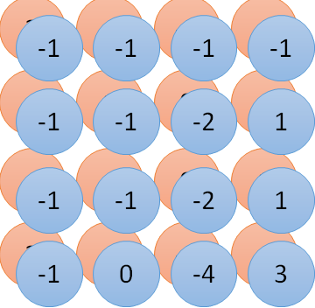
Convolution v.s. Fully Connected
1 | 0 | 0 | 0 | 0 | 1
0 | 1 | 0 | 0 | 1 | 0
0 | 0 | 1 | 1 | 0 | 0
1 | 0 | 0 | 0 | 1 | 0
0 | 1 | 0 | 0 | 1 | 0
0 | 0 | 1 | 0 | 1 | 0
1 | -1 | -1
-1 | 1 | -1
-1 | -1 | 1
-1 | 1 | -1
-1 | 1 | -1
-1 | 1 | -1
convolution
image
1 | 0 | 0 | 0 | 0 | 1
0 | 1 | 0 | 0 | 1 | 0
0 | 0 | 1 | 1 | 0 | 0
1 | 0 | 0 | 0 | 1 | 0
0 | 1 | 0 | 0 | 1 | 0
0 | 0 | 1 | 0 | 1 | 0
Fully-connected
……
……

Slide 40
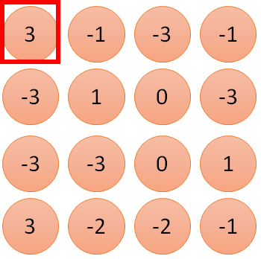
1 | -1 | -1
-1 | 1 | -1
-1 | -1 | 1
1
1
Filter 1
2
0
3
0
3
4:
0
1 | 0 | 0 | 0 | 0 | 1
0 | 1 | 0 | 0 | 1 | 0
0 | 0 | 1 | 1 | 0 | 0
1 | 0 | 0 | 0 | 1 | 0
0 | 1 | 0 | 0 | 1 | 0
0 | 0 | 1 | 0 | 1 | 0
…
0
8
1
9
0
10:
0
…
13
0
6 x 6 image
14
0
fewer parameters!
15
Only connect to 9 inputs, not fully connected
1
16
1
…

Slide 41
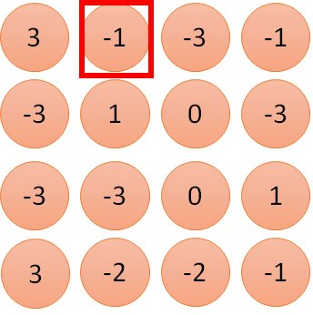
1 | -1 | -1
-1 | 1 | -1
-1 | -1 | 1
1:
1
Filter 1
2:
0
3:
0
3
4:
0
1 | 0 | 0 | 0 | 0 | 1
0 | 1 | 0 | 0 | 1 | 0
0 | 0 | 1 | 1 | 0 | 0
1 | 0 | 0 | 0 | 1 | 0
0 | 1 | 0 | 0 | 1 | 0
0 | 0 | 1 | 0 | 1 | 0
…
7:
0
8:
1
-1
9:
0
10:
0
…
13:
0
6 x 6 image
14:
0
Fewer parameters
15:
1
16:
1
Shared weights
Even fewer parameters
…

Slide 42
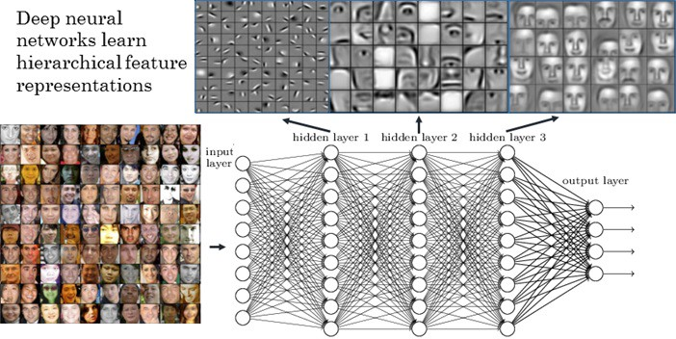
Visualize the Results

Slide 43
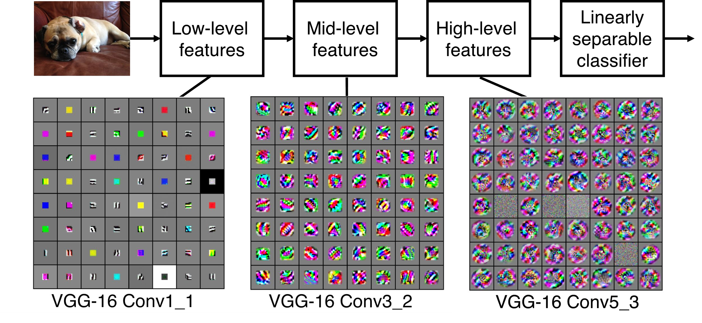
Preview
[Zeiler and Fergus 2013]
Visualization of VGG-16 by Lane McIntosh. VGG-16 architecture from [Simonyan and Zisserman 2014].
Fei-Fei Li & Justin Johnson & Serena Yeung April 18, 2017Lecture 5 -

Slide 44
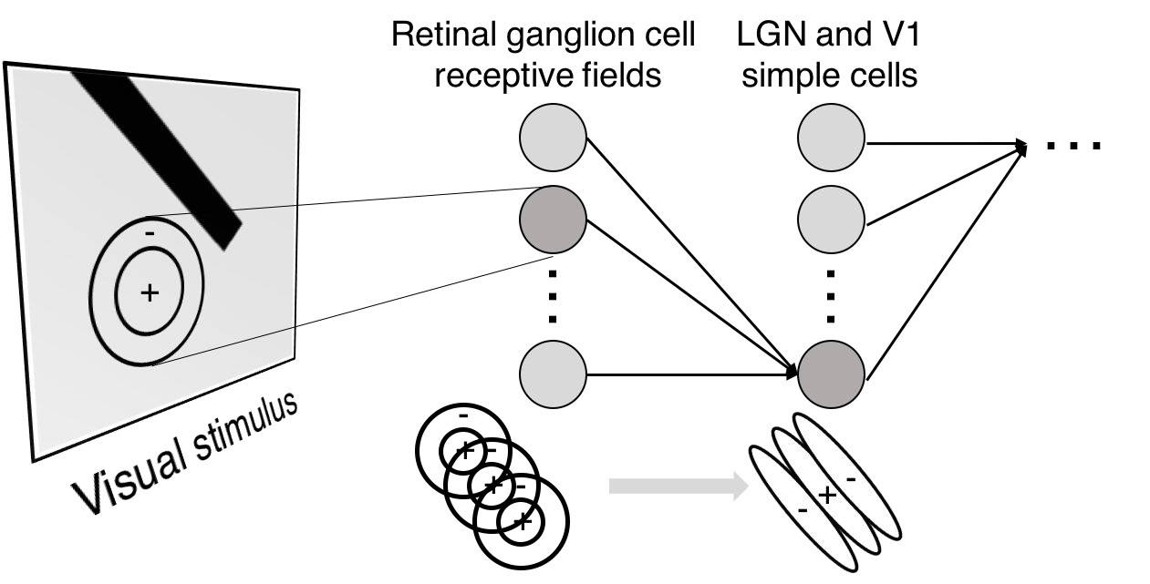
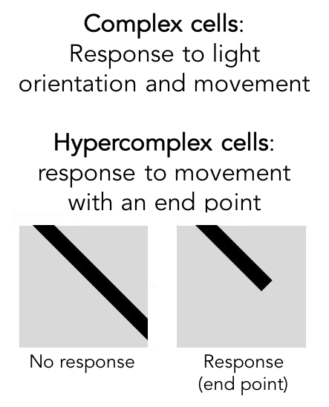
Preview

Slide 45
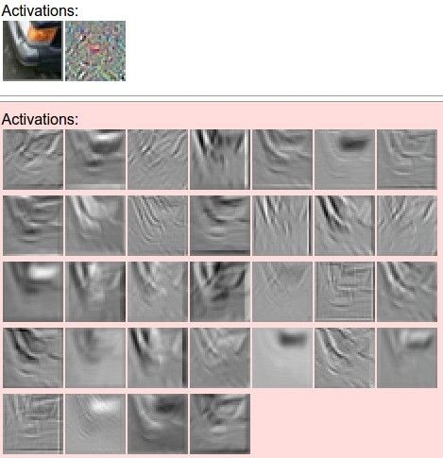
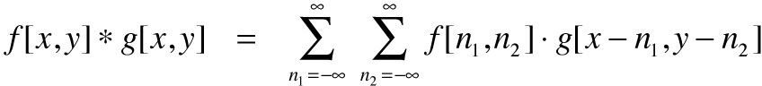
one filter =>
one activation map
example 5x5 filters
(32 total)
We call the layer convolutional because it is related to convolution of two signals:
elementwise multiplication and sum of a filter and the signal (image)
Figure copyright Andrej Karpathy.

Slide 46

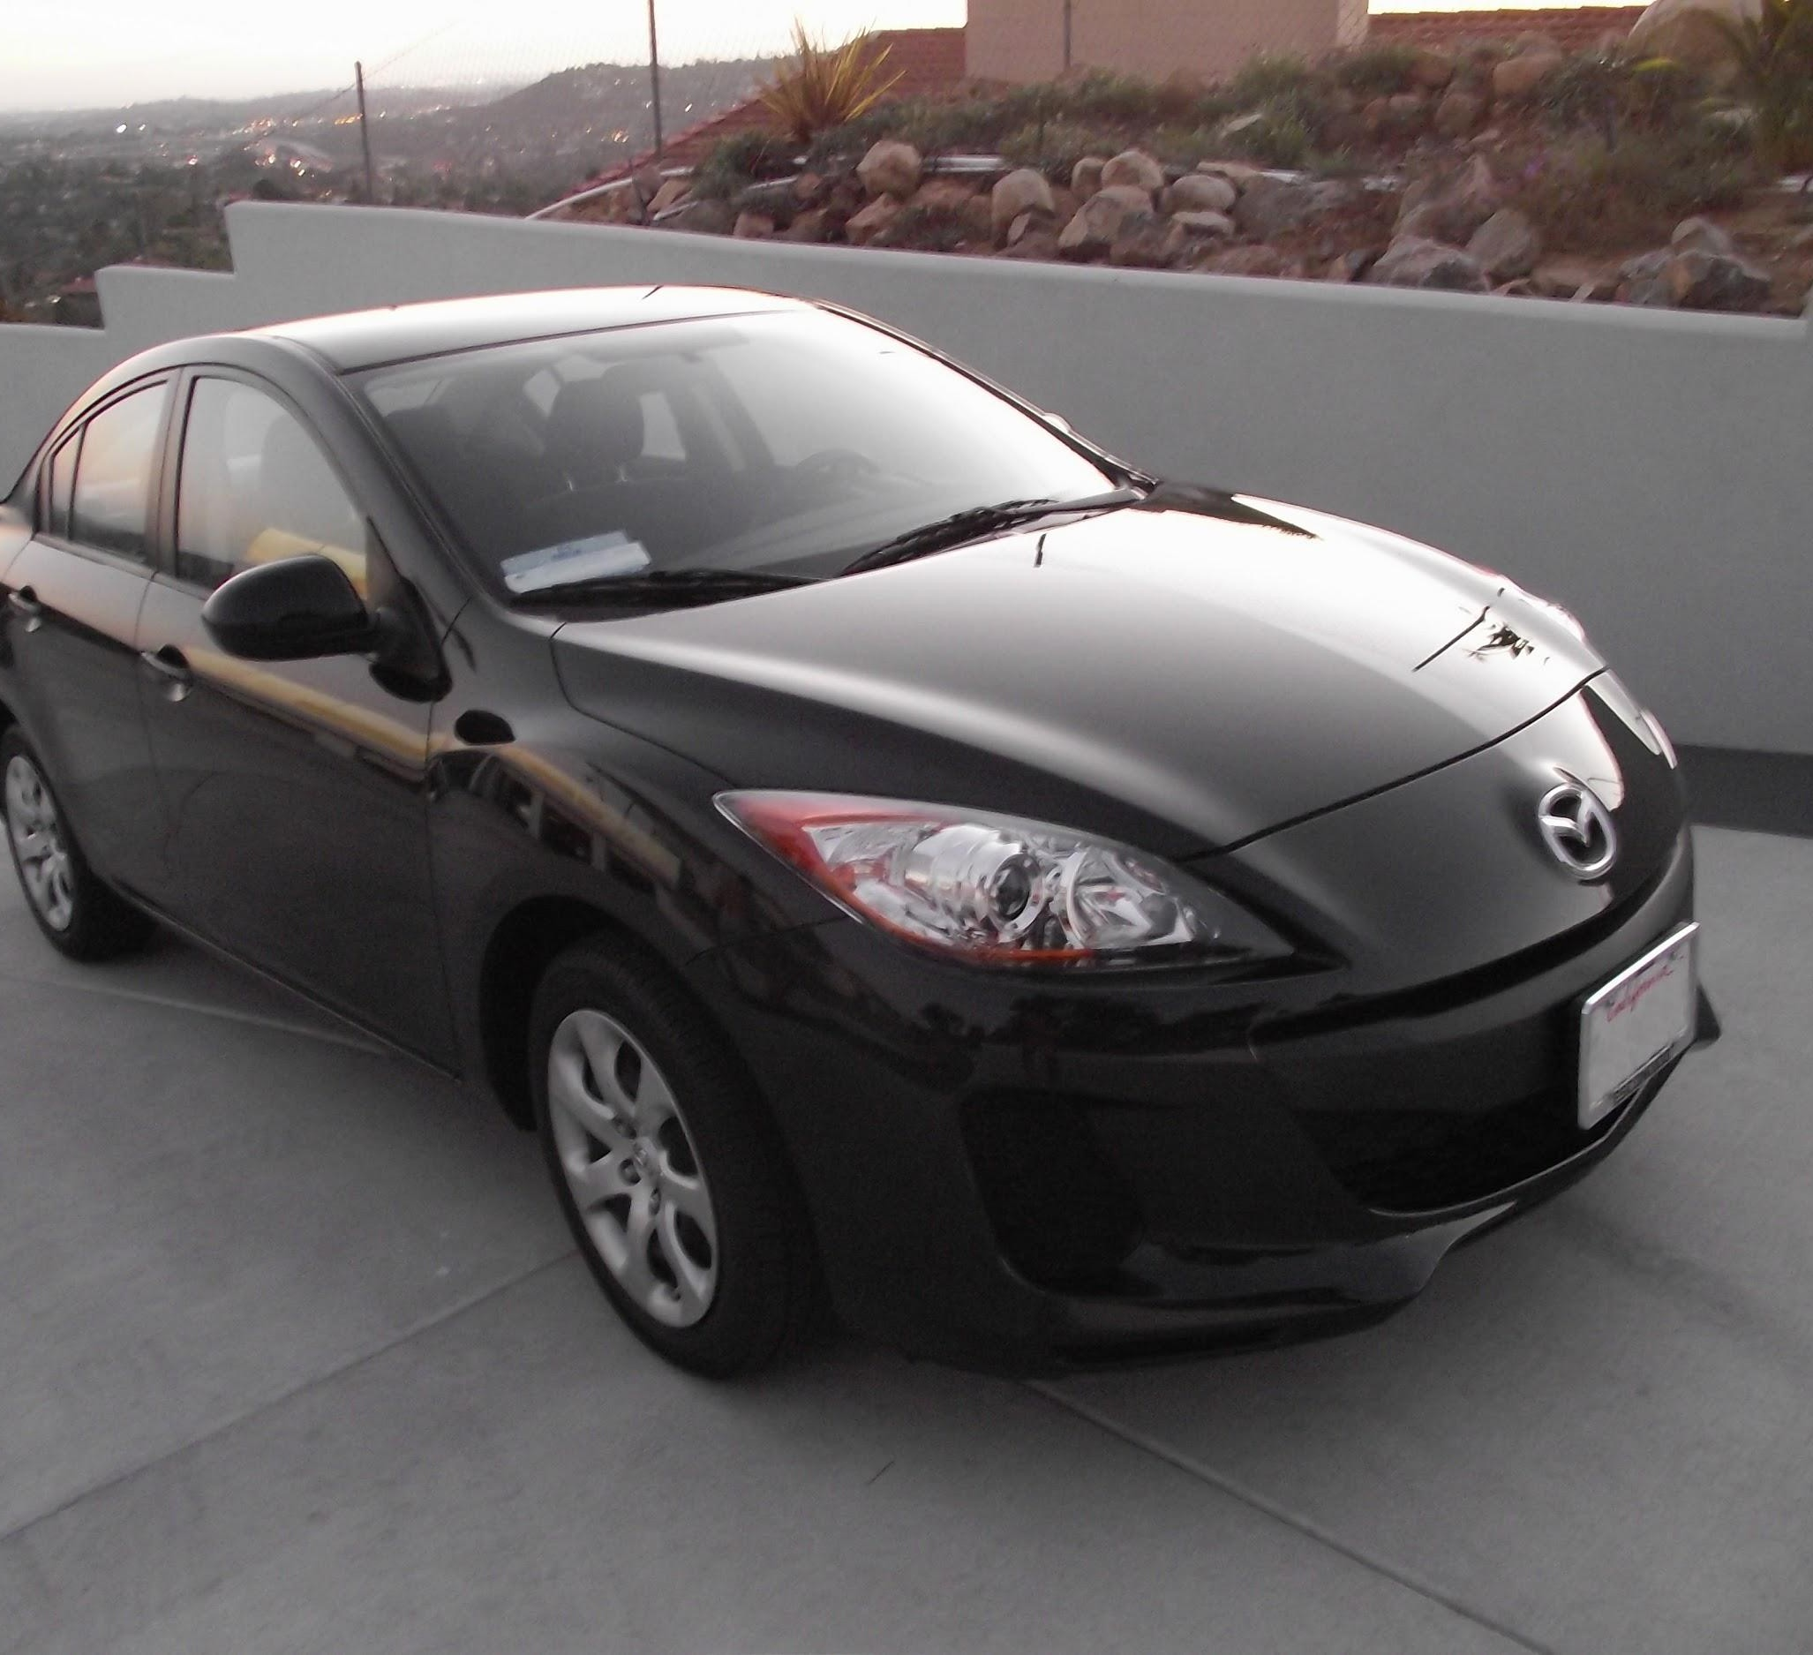
preview:
Fei-Fei Li & Justin Johnson & Serena Yeung April 18, 2017Lecture 5 -

Slide 47


The whole CNN
cat dog ……
Convolution
Max Pooling
Can repeat many times
Fully Connected Feedforward network
Convolution
Max Pooling
Flattened

Slide 48
Flattening
3
0
1
3
0
-1
1
3
3
1
-1
0
3
Flattened
1
Fully Connected Feedforward network
0
3

Slide 49
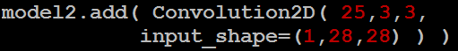
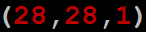
CNN in Keras
Only modified the network structure and input format (vector -> 3-D tensor)
input
Convolution
1 | -1 | -1
-1 | 1 | -1
-1 | -1 | 1
-1 | 1 | -1
-1 | 1 | -1
-1 | 1 | -1
There are 25 3x3 filters.
……
Max Pooling
Input_shape = ( 28 , 28 , 1)
28 x 28 pixels
1: black/white, 3: RGB
Convolution
3
-1
3
Max Pooling
-3
1

Slide 50
CNN in Keras
Only modified the network structure and input format (vector -> 3-D array)
Input
1 x 28 x 28
Convolution
How many parameters for each filter?
9
25 x 26 x 26
Max Pooling
25 x 13 x 13
Convolution
How many parameters
for each filter?
225=
25x9
50 x 11 x 11
Max Pooling
50 x 5 x 5

Slide 51
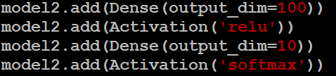
CNN in Keras
Only modified the network structure and input format (vector -> 3-D array)
Input
1 x 28 x 28
Output
Convolution
25 x 26 x 26
Fully connected feedforward network
Max Pooling
25 x 13 x 13
Convolution
50 x 11 x 11
Max Pooling
1250
50 x 5 x 5
Flattened

Slide 52
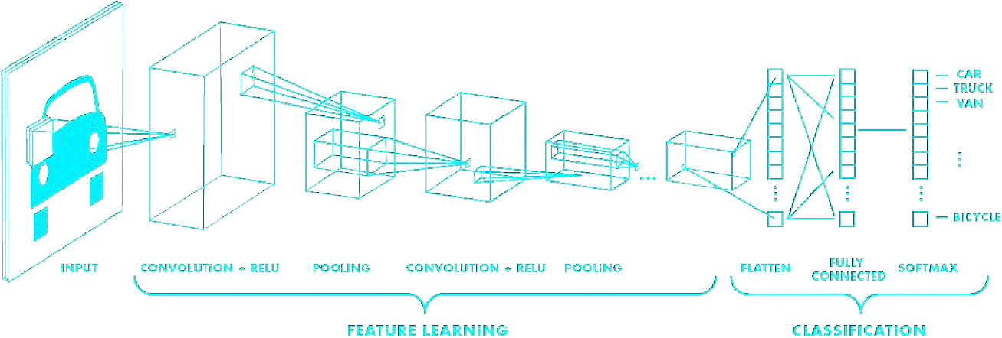
Putting it all together
import tensorflow as tf
def generate_model():
model = tf.keras.Sequential([ # first convolutional layer
tf.keras.layers.Conv2D(32, filter_size=3, activation='relu’), tf.keras.layers.MaxPool2D(pool_size=2, strides=2),
# second convolutional layer
tf.keras.layers.Conv2D(64, filter_size=3, activation='relu’), tf.keras.layers.MaxPool2D(pool_size=2, strides=2),
# fully connected classifier tf.keras.layers.Flatten(), tf.keras.layers.Dense(1024, activation='relu’), tf.keras.layers.Dense(10, activation=‘softmax’) # 10 outputs
])
return model

Slide 53
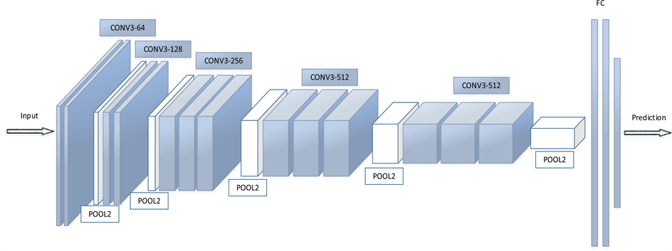
Fully Connected Layers

Slide 54
Fully Connected Layers
Regular neural network
This layer takes an input volume from last layer of CNN and outputs an N dimensional vector.
Where N is the number of classes

Slide 55
Pooling Layer
Pooling is used to progressively reduce the spatial size of the input
To reduce the amount of parameters and computation
It control overfitting (regularization).
Invariance to small translations of the input
Commonly insert a Pooling layer in-between successive Conv layers

Slide 56
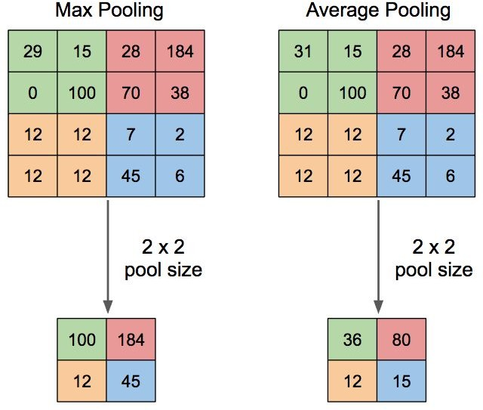
Pooling Layer

Slide 57
Dropout
The term “dropout” refers to dropping out units (both hidden and visible) in a neural network.
It is a way to preventing overfitting problem
These units are not considered during a particular forward or backward pass
A new hyperparameter is introduced that specifies the probability at which outputs of the layer are dropped out
Dropout: A Simple Way to Prevent Neural Networks from Overfitting

Slide 58
References
https://www.deeplearningbook.org/contents/convnets.html
https://www.deeplearningbook.org/contents/mlp.html
Dropout: A Simple Way to Prevent Neural Networks from Overfitting
https://arxiv.org/abs/1502.03167

Slide 59
Thank You ☺

